Slide 1
Unit-1
Industry Trends and the Future of Cloud Computing

Slide 2
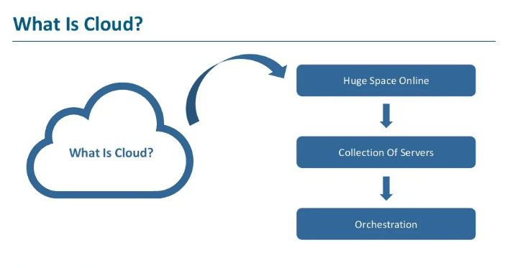

Slide 3
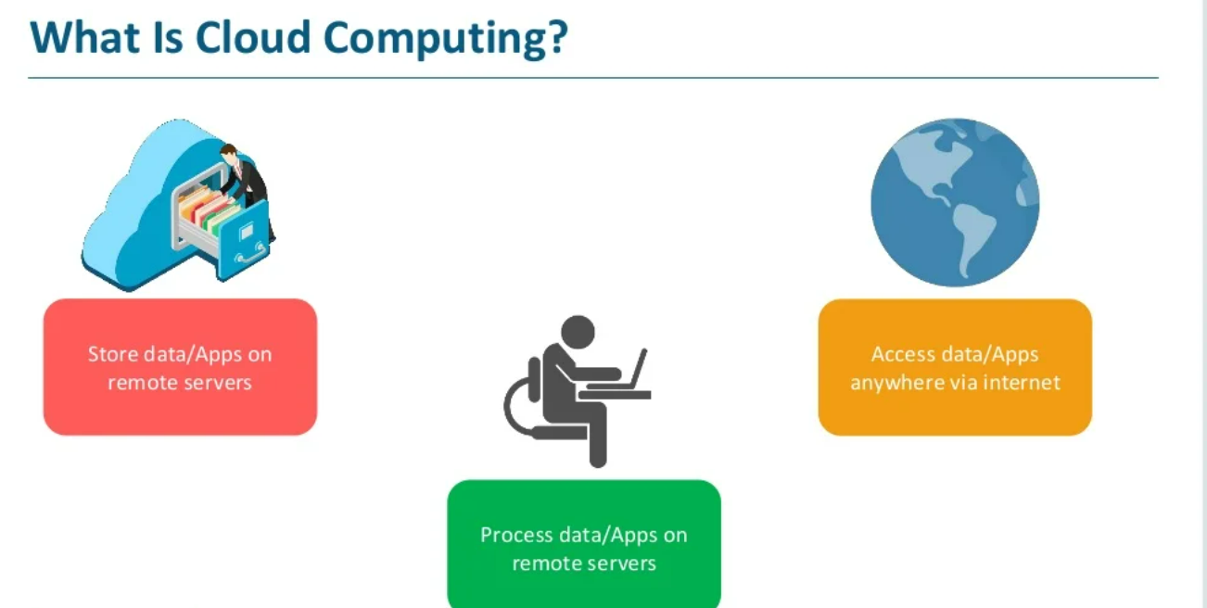

Slide 4
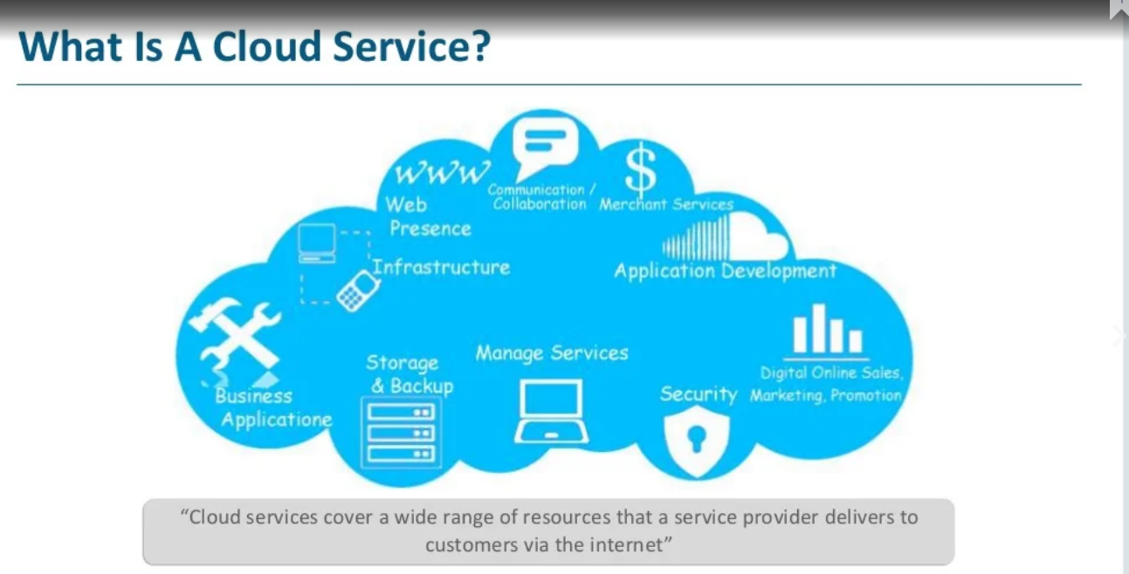

Slide 5
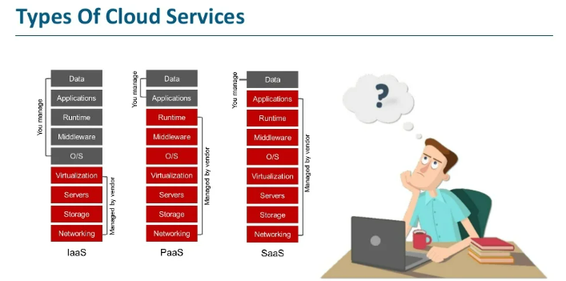

Slide 6
What is Cloud Computing?
Cloud Computing is a general term used to describe a new class of network based computing that takes place over the Internet,
basically a step on from Utility Computing
a collection/group of integrated and networked hardware, software, and Internet infrastructure (called a platform).
Using the Internet for communication and transport provides hardware, software, and networking services to clients
These platforms hide the complexity and details of the underlying infrastructure from users and applications by providing very simple graphical interface or API (Applications Programming Interface).

Slide 7
What is Cloud Computing?
In addition, the platform provides on demand services, that are always on, anywhere, anytime and any place.
Pay for use and as needed, elastic
scale up and down in capacity and functionalities
The hardware and software services are available to
general public, enterprises, corporations and businesses markets

Slide 8
Cloud Summary
Cloud computing is an umbrella term used to refer to Internet based development and services
A number of characteristics define cloud data, applications services and infrastructure:
Remotely hosted: Services or data are hosted on remote infrastructure.
Ubiquitous: Services or data are available from anywhere.
Commodified: The result is a utility computing model similar to traditional that of traditional utilities, like gas and electricity - you pay for what you would want!

Slide 9
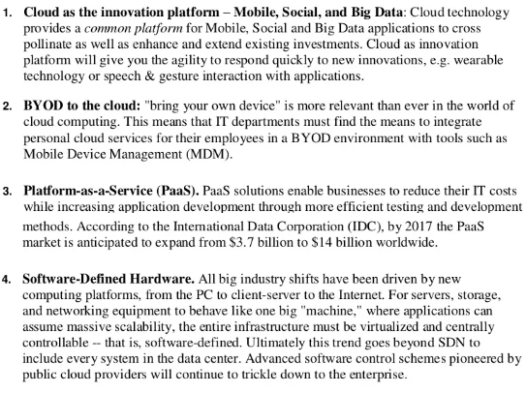
Recent Trends in Cloud Computing

Slide 10
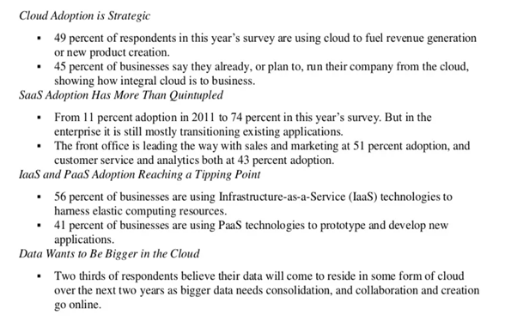

Slide 11
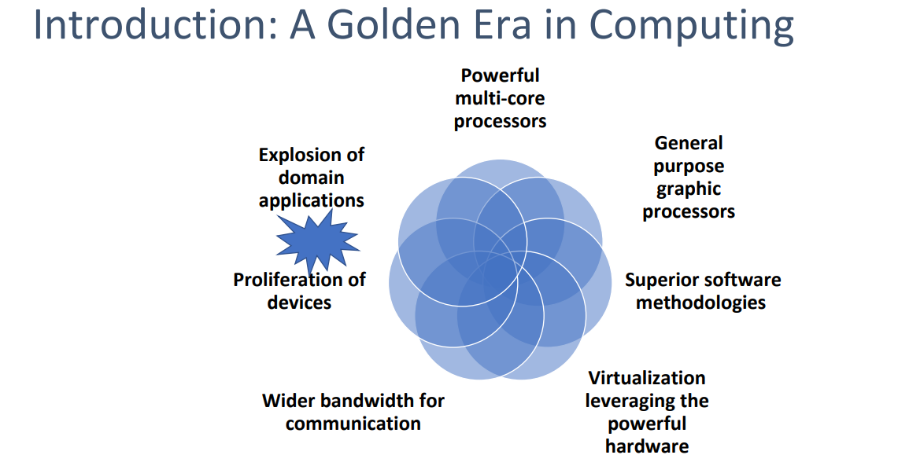

Slide 12
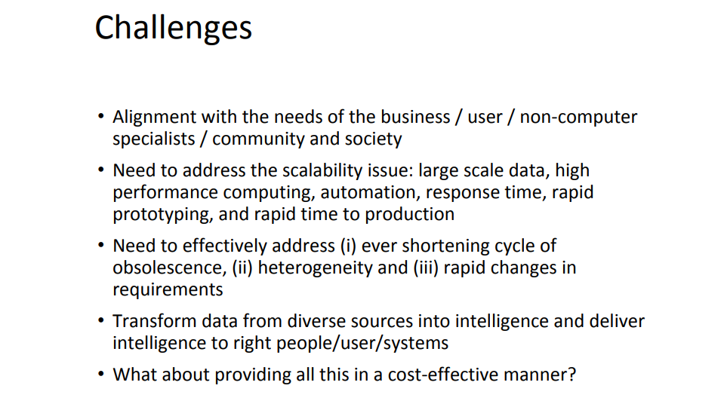

Slide 13
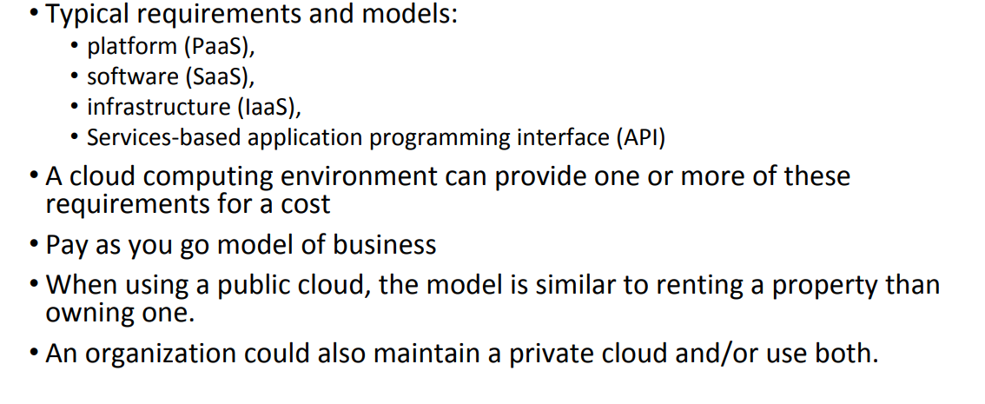

Slide 14
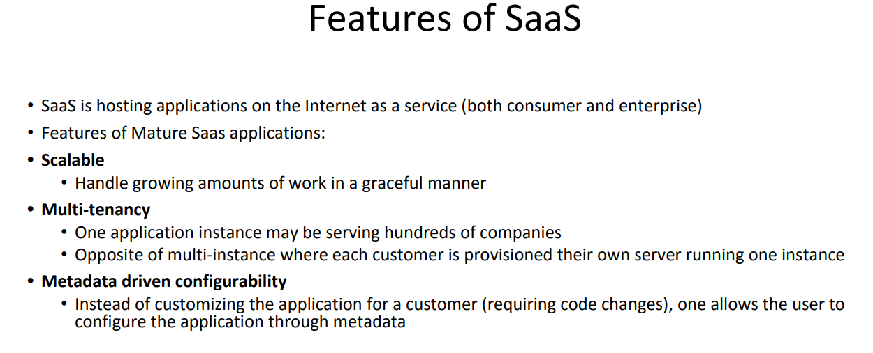

Slide 15
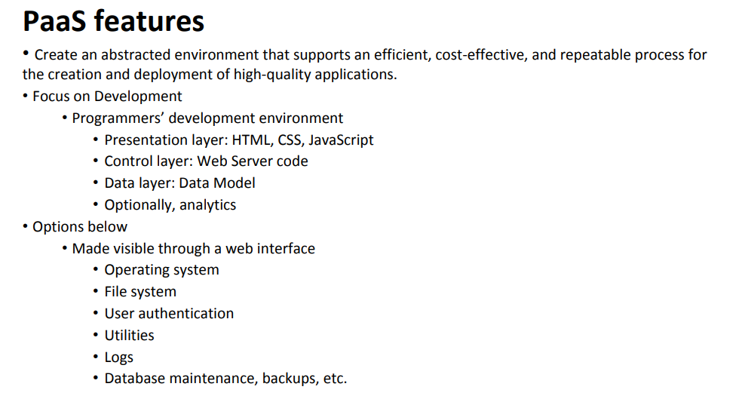

Slide 16
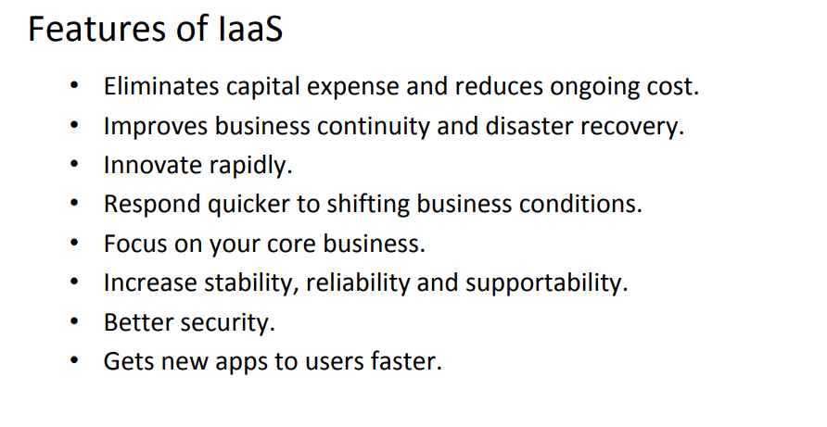

Slide 17
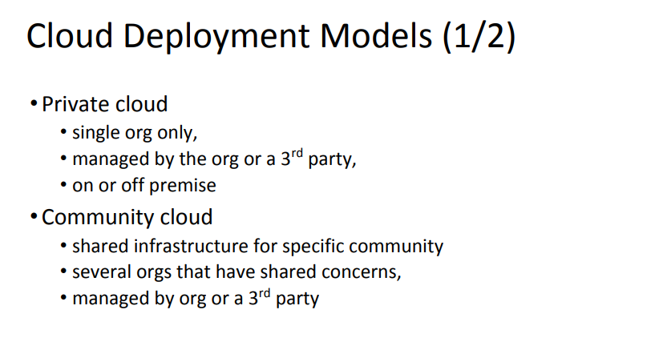

Slide 18
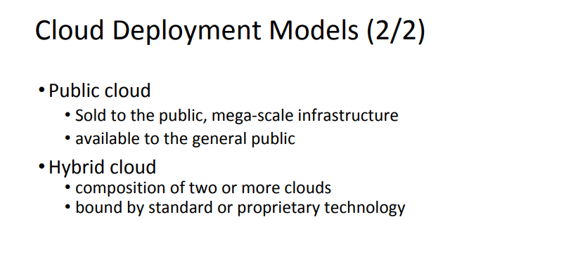

Slide 19
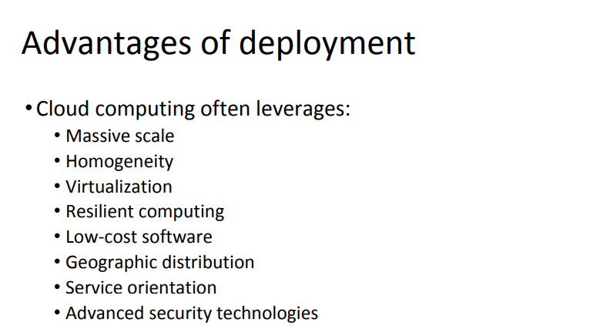

Slide 20
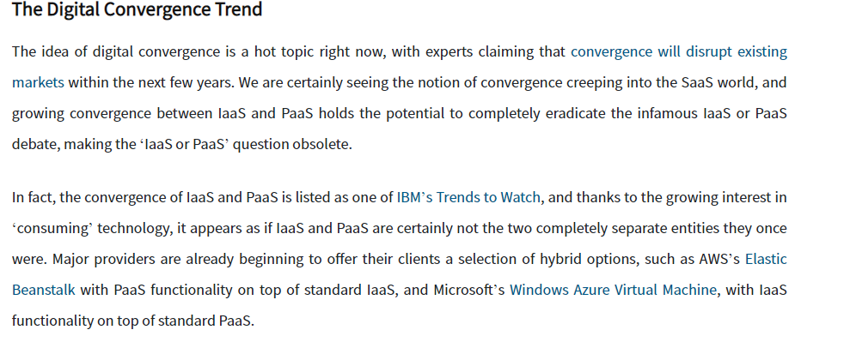

Slide 21
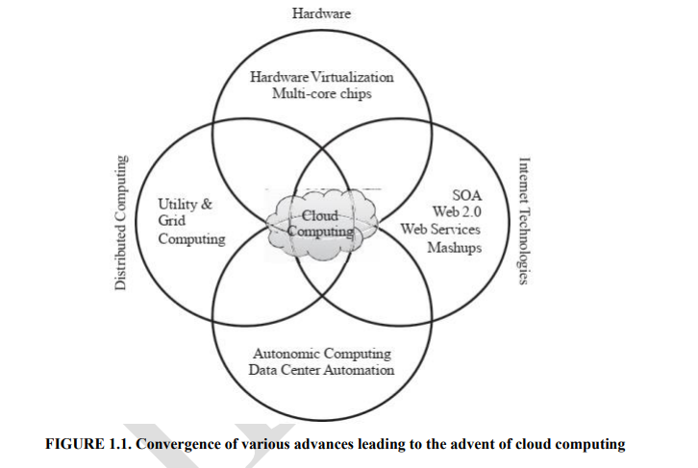

Slide 22
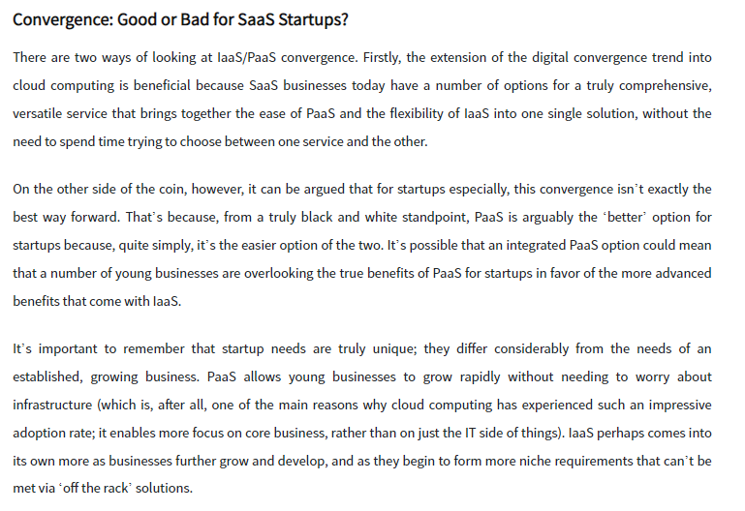

Slide 23
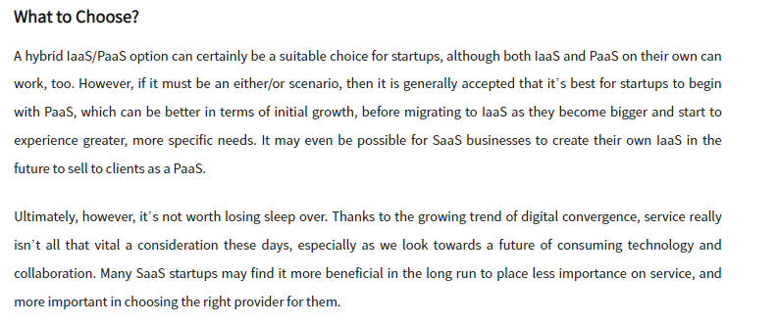

Slide 24
Hyper-convergence and Private Cloud
Hyper-convergence has been one of the biggest IT trends of the last 24 months, with start-ups and existing technology vendors offering a suite of hardware and software solutions. Many have conflated hyper-convergence and private cloud to mean one way of deploying and managing IT infrastructure and applications. Although there are many similarities between the two technologies (and hyper-convergence does enable private cloud) one can’t simply be replaced with another. As we will discuss, hyper-convergence is an enabler, not a definition of, private cloud and there are a number of components that are missing from hyper-convergence that make it a complete cloud solution. As we walk through what cloud means, we will discuss hyper-convergence and the gaps that have to be filled in delivering a true private cloud solution.

Slide 25
The Rise of Hyper-Convergence
Hyper-convergence represents an evolution of converged infrastructure solutions that were introduced to the market in 2009. In reality, converged infrastructure was simply packaged solutions comprising server, storage, and networking where the vendor had brought together their own products and pre-certified the solution for compatibility. Some vendors added orchestration tools and developed pre-tested configurations for specific application workloads. Converged solutions don’t provide the ability to implement a private cloud, as the technology is usually difficult to expand on-demand, typically requiring the deployment of another “chunk” of infrastructure to add new resources. The saving here is in the design and configuration of the hardware, rather than the operation of the IT service.
Hyper-convergence goes a step further by merging the separate hardware components (server and storage) into a single physical form factor. The services that were previously provided by a dedicated storage array are now delivered through software using a distributed storage platform across all of the servers in a multi-node cluster configuration. Hyper-converged solutions deliver resiliency at both the disk and node level; if a disk fails in a server, the data can be recreated elsewhere in the cluster; if a node fails the compute is moved and the data recreated on a different node.

Slide 26
Hyper-convergence within a Private Cloud Strategy
As we start to compare private cloud and hyper-converged solutions, we can see that both are aligned in the way that resources are deployed and consumed. This alignment implies that hyper-converged solutions can be used as part of a private cloud strategy. Looking back at our cloud definitions, taking each in turn:
Elasticity – cloud services enable scaling up or down on demand. Hyper-converged solutions typically provide this capability. Compute and storage (capacity & performance) can be increased by adding nodes to a hyper-converged configuration. The process of adding nodes is typically quick and handled by the hyper-converged platform directly, with resources rebalanced across all nodes. This highly granular incremental process for increasing resource capacity allows private cloud providers to be responsive to their internal customers; the process of adding nodes takes hours rather than the days or months that traditional resource deployment takes. Simply adding nodes to a configuration removes all of the design and planning work traditionally associated with deploying server and storage infrastructure. From a financial perspective, adding a node can be achieved at a lower incremental cost than having to deploy an entire storage array or new server cluster. It’s worth mentioning however that just-in-time purchasing of new equipment may be difficult to reconcile against budgets that are planned 12 months or more in advance.
On-Demand – cloud services should allow end users to consume resources on-demand. Hyper-converged solutions certainly provide the basis to deliver an on-demand service. In most solutions, the physical attributes such as storage LUNs or volumes are abstracted away from the end user. Storage is typically implemented as a distributed file system across all nodes and so the LUN/volume concept simply doesn’t exist. The placement of virtual machines across the node cluster isn’t a concern of the end user. Many solutions automate this process (in conjunction with hypervisor resource leveling features) so the user just has to know that the VM exists somewhere in the cluster. This makes it much easier to deploy virtual machines using quantitative descriptions like logical disk size, virtual memory and number of logical processors. As long as sufficient resource capacity exists in the whole cluster, then there’s no other consideration.

Slide 27
Hyper-convergence within a Private Cloud Strategy
Resource Pooling – as we dig further into the cloud definitions, we can already see that pooling of resources is a key feature of hyper-converged solutions. Storage exists as one logical pool across the cluster, with most solutions permitting heterogeneous configurations (nodes of different hardware configurations). VMs are deployed to servers with the right level of available resources. This resource management capability is one of the key features of hyper-converged solutions, in that the benefit of using hyper-converged over “DIY” is the ability to automate resource management.
Broad Network Access – this feature really doesn’t talk to hyper-converged but rather reflects how hyper-converged solutions are integrated into an existing infrastructure framework. As with any server/storage hardware, hyper-converged solutions provide the same access capabilities as any hardware deployment.
Measurability – in the private cloud we want the ability to measure the consumption of resources because the billing is based on service offerings rather than hardware. Hyper-converged solutions abstract resources and provide the capability to report on resource consumption, however a question to ask is whether this reporting is mature enough for private cloud environments. We will discuss the maturity level of this requirement in a moment.

Slide 28
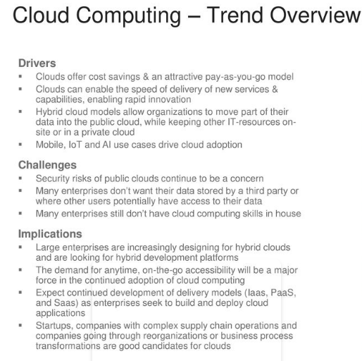

Slide 29
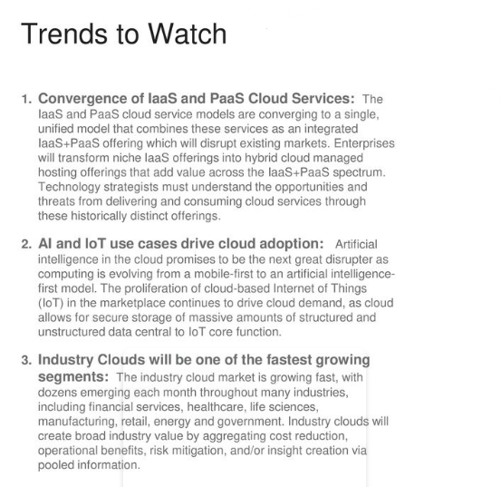

Slide 30
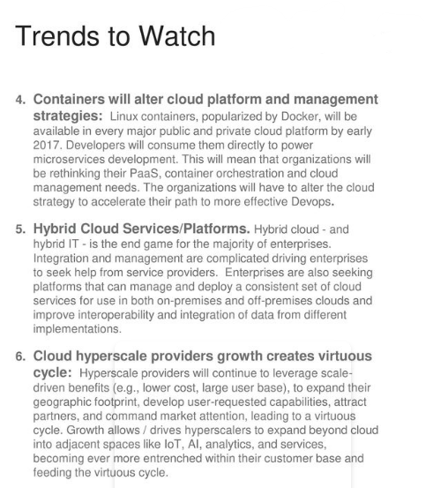

Slide 31
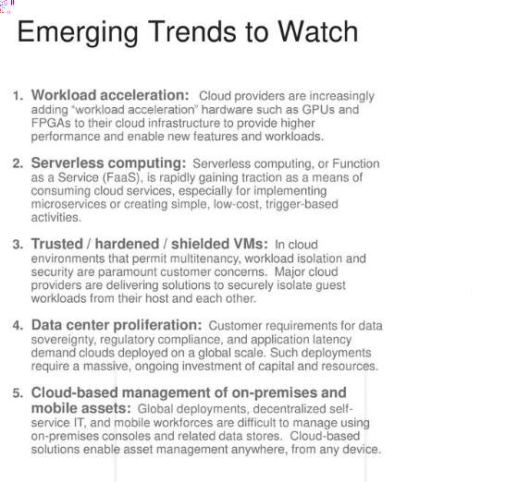

Slide 32
Cloud-Sourcing
Why is it becoming a Big Deal:
Using high-scale/low-cost providers,
Any time/place access via web browser,
Rapid scalability; incremental cost and load sharing,
Can forget need to focus on local IT.
Concerns:
Performance, reliability, and SLAs,
Control of data, and service parameters,
Application features and choices,
Interaction between Cloud providers,
No standard API – mix of SOAP and REST!
Privacy, security, compliance, trust…

Slide 33
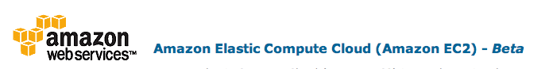


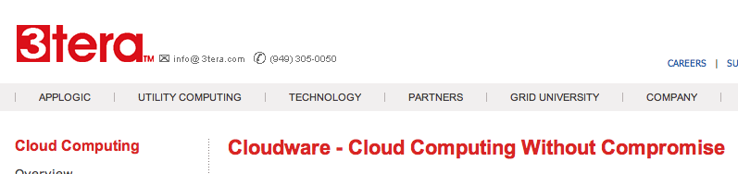






Some Commercial Cloud Offerings

Slide 34
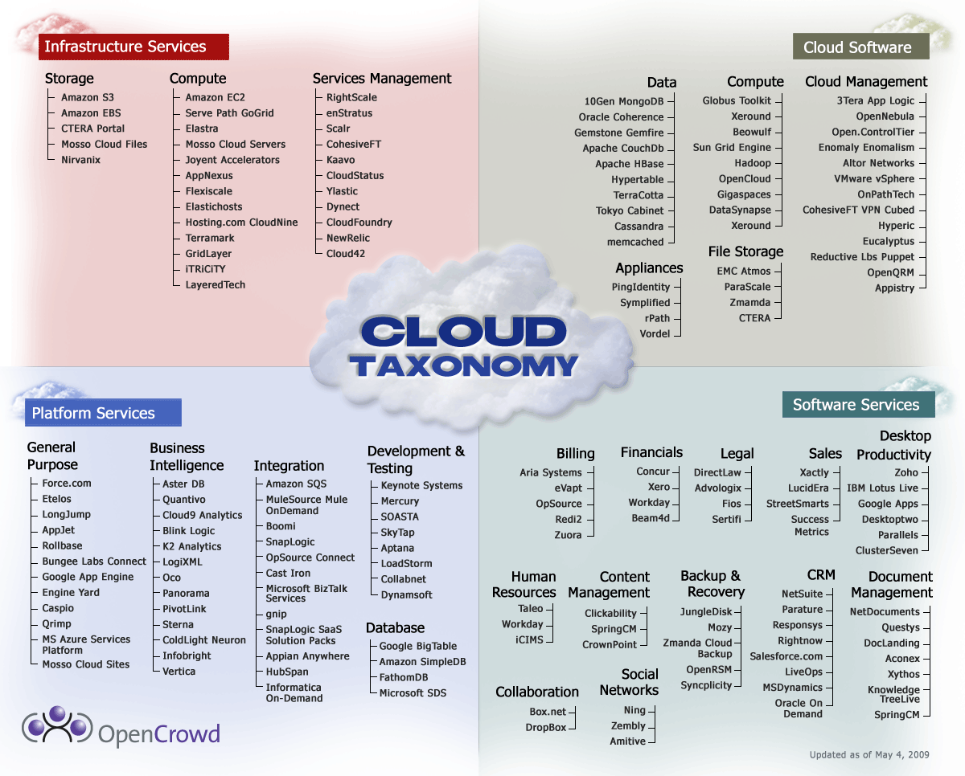
Cloud Taxonomy
Notes:
http://www.opencrowd.com/assets/images/views/views_cloud-tax-lrg.png

Slide 35
Opportunities and Challenges
The use of the cloud provides a number of opportunities:
It enables services to be used without any understanding of their infrastructure.
Cloud computing works using economies of scale:
It potentially lowers the outlay expense for start up companies, as they would no longer need to buy their own software or servers.
Cost would be by on-demand pricing.
Vendors and Service providers claim costs by establishing an ongoing revenue stream.
Data and services are stored remotely but accessible from “anywhere”.

Slide 36
Opportunities and Challenges
In parallel there has been backlash against cloud computing:
Use of cloud computing means dependence on others and that could possibly limit flexibility and innovation:
The others are likely become the bigger Internet companies like Google and IBM, who may monopolise the market.
Some argue that this use of supercomputers is a return to the time of mainframe computing that the PC was a reaction against.
Security could prove to be a big issue:
It is still unclear how safe out-sourced data is and when using these services ownership of data is not always clear.
There are also issues relating to policy and access:
If your data is stored abroad whose policy do you adhere to?
What happens if the remote server goes down?
How will you then access files?
There have been cases of users being locked out of accounts and losing access to data.
Notes:
Freedom of Information == FOI

Slide 37
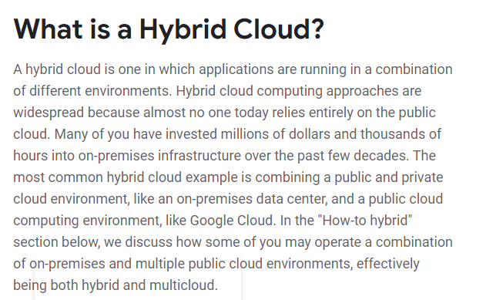

Slide 38
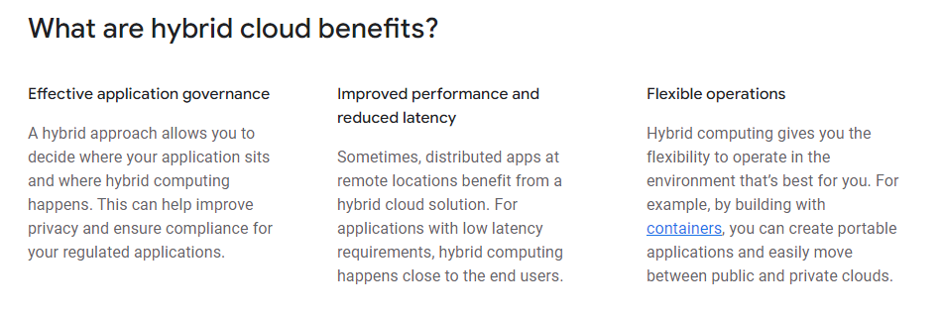

Slide 39
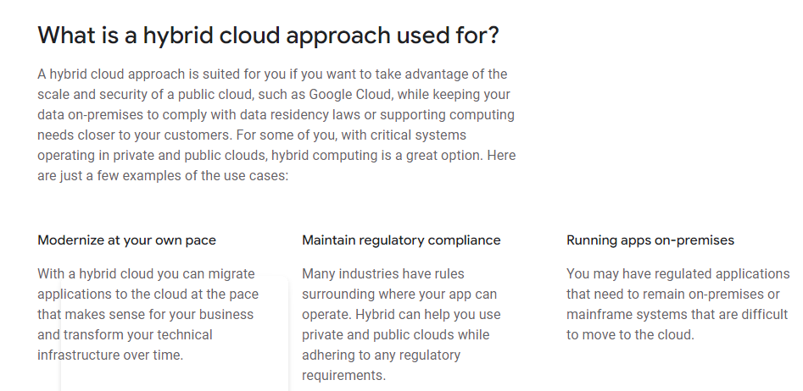

Slide 40
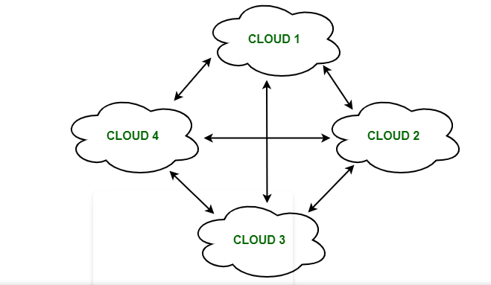
What is Cloud Federation?
Cloud Federation, also known as Federated Cloud is the deployment and management of several external and internal cloud computing services to match business needs. It is a multi-national cloud system that integrates private, community, and public clouds into scalable computing platforms. A Federated cloud is created by connecting the cloud environment of different cloud providers using a common standard.

Slide 41
The architecture of Federated Cloud:
The architecture of Federated Cloud consists of three basic components:
1. Cloud Exchange
The Cloud Exchange acts as a mediator between the cloud coordinator and the cloud broker. The demands of the cloud broker are mapped by the cloud exchange to the available services provided by the cloud coordinator. The cloud exchange has a track record of what is the present cost, demand patterns, and available cloud providers, and this information is periodically reformed by the cloud coordinator.
2. Cloud Coordinator
The cloud coordinator assigns the resources of the cloud to the remote users based on the quality of service they demand and the credits they have in the cloud bank. The cloud enterprises and their membership are managed by the cloud controller.
3. Cloud Broker
The cloud broker interacts with the cloud coordinator and analyzes the Service-level agreement and the resources offered by several cloud providers in cloud exchange. Cloud broker finalizes the most suitable deal for their client.

Slide 42
Properties of Federated Cloud:
In the federated cloud, the users can interact with the architecture either centrally or in a decentralized manner. In centralized interaction, the user interacts with a broker to mediate between them and the organization. Decentralized interaction permits the user to interact directly with the clouds in the federation.
Federated cloud can be practiced with various niches like commercial and non-commercial.
The visibility of a federated cloud assists the user to interpret the organization of several clouds in the federated environment.
Federated cloud can be monitored in two ways. MaaS (Monitoring as a Service) provides information that aids in tracking contracted services to the user. Global monitoring aids in maintaining the federated cloud.
The providers who participate in the federation publish their offers to a central entity. The user interacts with this central entity to verify the prices and propose an offer.
The marketing objects like infrastructure, software, and platform have to pass through federation when consumed in the federated cloud.

Slide 43
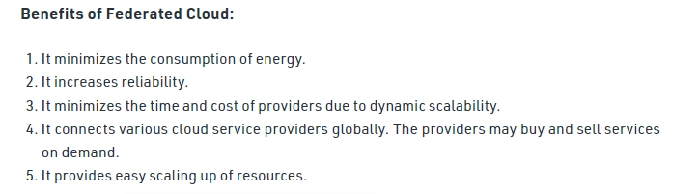

Slide 44
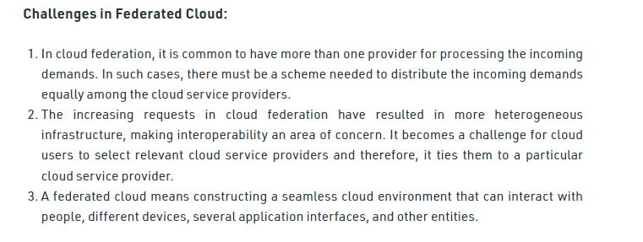

Slide 45
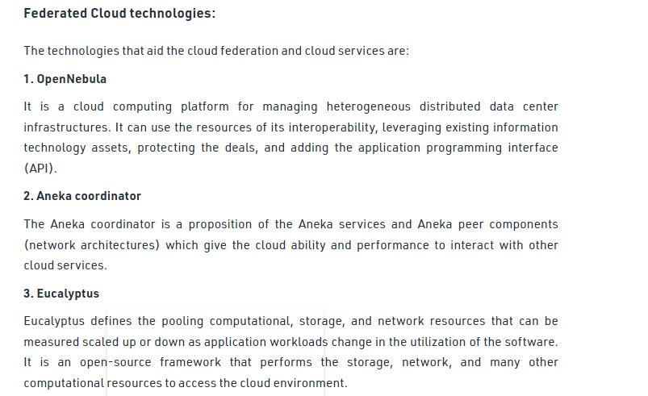

Slide 46
The Future
Many of the activities loosely grouped together under cloud computing have already been happening and centralised computing activity is not a new phenomena
Grid Computing was the last research-led centralised approach
However there are concerns that the mainstream adoption of cloud computing could cause many problems for users
Many new open source systems appearing that you can install and run on your local cluster
should be able to run a variety of applications on these systems

Slide 47
Advantages of Cloud Computing
Lower computer costs:
You do not need a high-powered and high-priced computer to run cloud computing's web-based applications.
Since applications run in the cloud, not on the desktop PC, your desktop PC does not need the processing power or hard disk space demanded by traditional desktop software.
When you are using web-based applications, your PC can be less expensive, with a smaller hard disk, less memory, more efficient processor...
In fact, your PC in this scenario does not even need a CD or DVD drive, as no software programs have to be loaded and no document files need to be saved.

Slide 48
Advantages of Cloud Computing
Improved performance:
With few large programs hogging your computer's memory, you will see better performance from your PC.
Computers in a cloud computing system boot and run faster because they have fewer programs and processes loaded into memory…
Reduced software costs:
Instead of purchasing expensive software applications, you can get most of what you need for free-ish!
most cloud computing applications today, such as the Google Docs suite.
better than paying for similar commercial software
which alone may be justification for switching to cloud applications.

Slide 49
Advantages of Cloud Computing
Instant software updates:
Another advantage to cloud computing is that you are no longer faced with choosing between obsolete software and high upgrade costs.
When the application is web-based, updates happen automatically
available the next time you log into the cloud.
When you access a web-based application, you get the latest version
without needing to pay for or download an upgrade.
Improved document format compatibility.
You do not have to worry about the documents you create on your machine being compatible with other users' applications or OSes
There are potentially no format incompatibilities when everyone is sharing documents and applications in the cloud.

Slide 50
Advantages of Cloud Computing
Unlimited storage capacity:
Cloud computing offers virtually limitless storage.
Your computer's current 1 Tbyte hard drive is small compared to the hundreds of Pbytes available in the cloud.
Increased data reliability:
Unlike desktop computing, in which if a hard disk crashes and destroy all your valuable data, a computer crashing in the cloud should not affect the storage of your data.
if your personal computer crashes, all your data is still out there in the cloud, still accessible
In a world where few individual desktop PC users back up their data on a regular basis, cloud computing is a data-safe computing platform!

Slide 51
Advantages of Cloud Computing
Universal document access:
That is not a problem with cloud computing, because you do not take your documents with you.
Instead, they stay in the cloud, and you can access them whenever you have a computer and an Internet connection
Documents are instantly available from wherever you are
Latest version availability:
When you edit a document at home, that edited version is what you see when you access the document at work.
The cloud always hosts the latest version of your documents
as long as you are connected, you are not in danger of having an outdated version

Slide 52
Advantages of Cloud Computing
Easier group collaboration:
Sharing documents leads directly to better collaboration.
Many users do this as it is an important advantages of cloud computing
multiple users can collaborate easily on documents and projects
Device independence.
You are no longer tethered to a single computer or network.
Changes to computers, applications and documents follow you through the cloud.
Move to a portable device, and your applications and documents are still available.

Slide 53
Disadvantages of Cloud Computing
Requires a constant Internet connection:
Cloud computing is impossible if you cannot connect to the Internet.
Since you use the Internet to connect to both your applications and documents, if you do not have an Internet connection you cannot access anything, even your own documents.
A dead Internet connection means no work and in areas where Internet connections are few or inherently unreliable, this could be a deal-breaker.

Slide 54
Disadvantages of Cloud Computing
Does not work well with low-speed connections:
Similarly, a low-speed Internet connection, such as that found with dial-up services, makes cloud computing painful at best and often impossible.
Web-based applications require a lot of bandwidth to download, as do large documents.
Features might be limited:
This situation is bound to change, but today many web-based applications simply are not as full-featured as their desktop-based applications.
For example, you can do a lot more with Microsoft PowerPoint than with Google Presentation's web-based offering

Slide 55
Disadvantages of Cloud Computing
Can be slow:
Even with a fast connection, web-based applications can sometimes be slower than accessing a similar software program on your desktop PC.
Everything about the program, from the interface to the current document, has to be sent back and forth from your computer to the computers in the cloud.
If the cloud servers happen to be backed up at that moment, or if the Internet is having a slow day, you would not get the instantaneous access you might expect from desktop applications.

Slide 56
Disadvantages of Cloud Computing
Stored data might not be secure:
With cloud computing, all your data is stored on the cloud.
The questions is How secure is the cloud?
Can unauthorised users gain access to your confidential data?
Stored data can be lost:
Theoretically, data stored in the cloud is safe, replicated across multiple machines.
But on the off chance that your data goes missing, you have no physical or local backup.
Put simply, relying on the cloud puts you at risk if the cloud lets you down.

Slide 57
Disadvantages of Cloud Computing
HPC Systems:
Not clear that you can run compute-intensive HPC applications that use MPI/OpenMP!
Scheduling is important with this type of application
as you want all the VM to be co-located to minimize communication latency!
General Concerns:
Each cloud systems uses different protocols and different APIs
may not be possible to run applications between cloud based systems
Amazon has created its own DB system (not SQL 92), and workflow system (many popular workflow systems out there)
so your normal applications will have to be adapted to execute on these platforms.

Slide 58
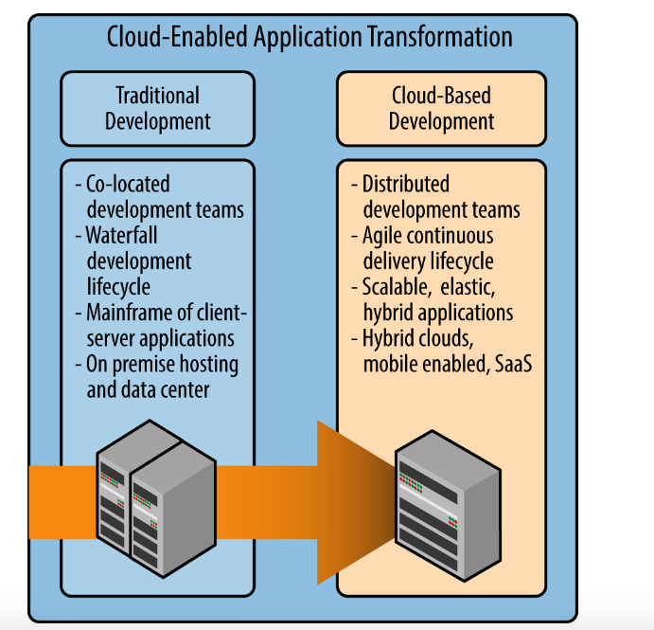

Slide 59
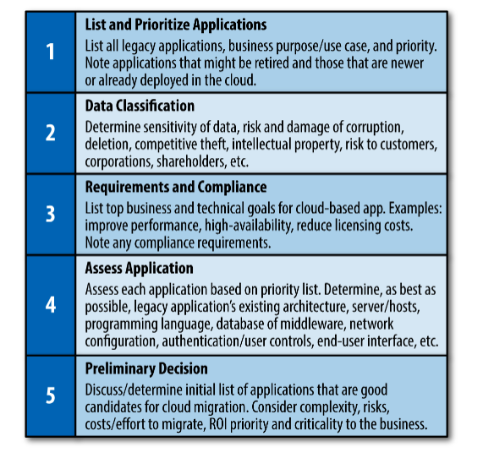

Slide 60
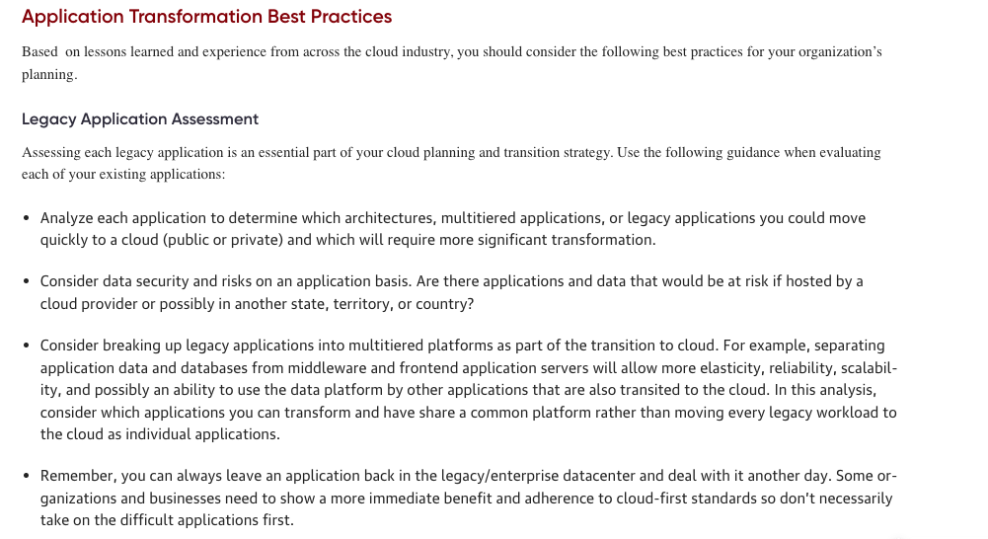

Slide 61
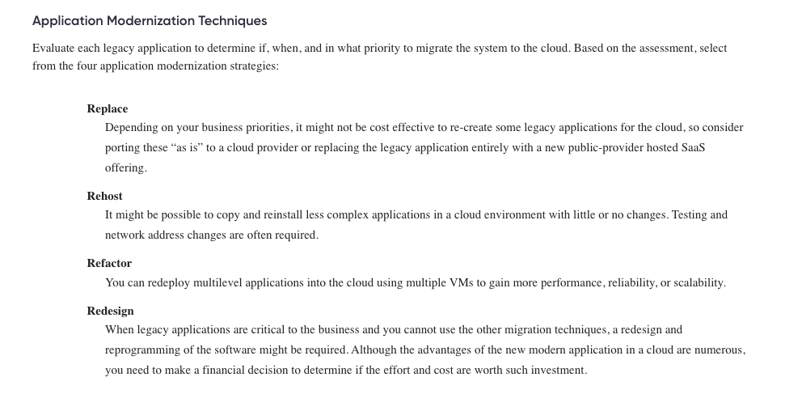

Slide 62
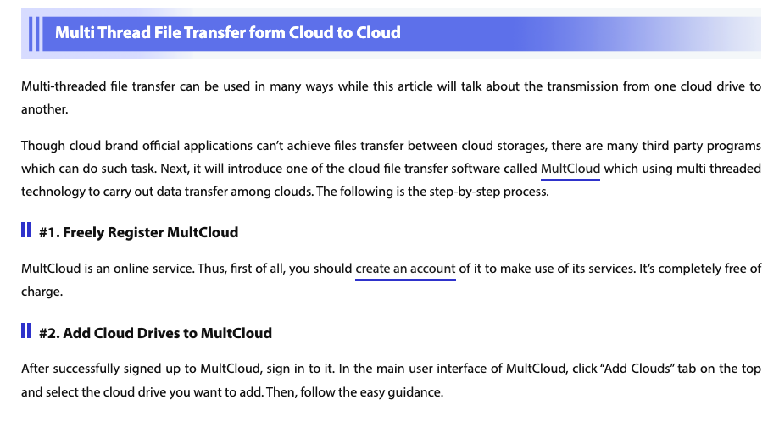
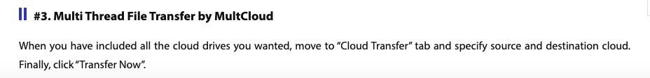

Slide 63
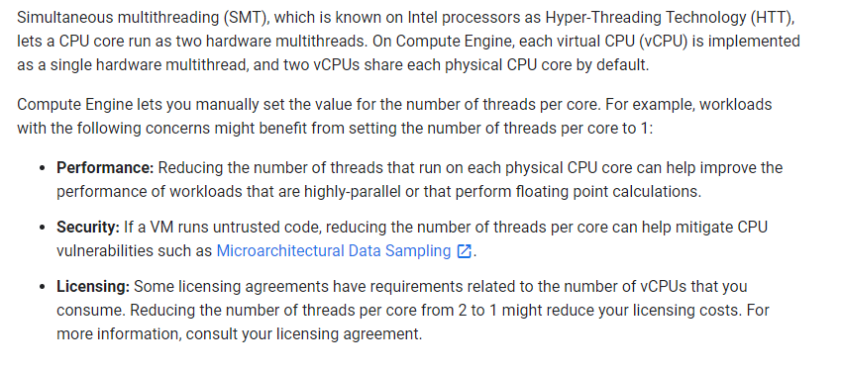
Fully Multithreading

Slide 64
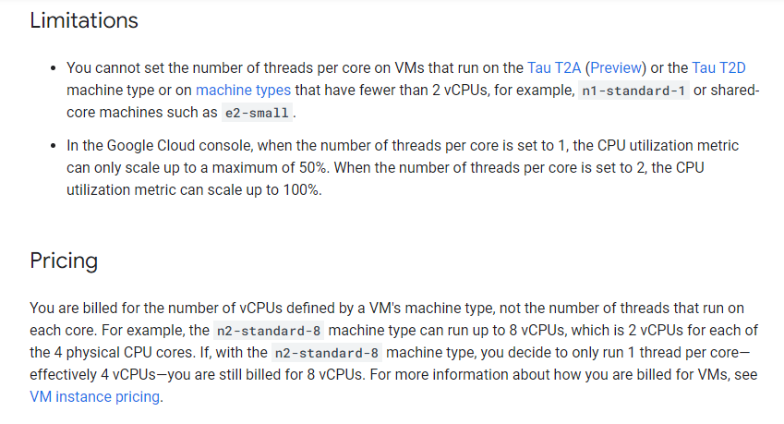
Fully Multithreading

Slide 65
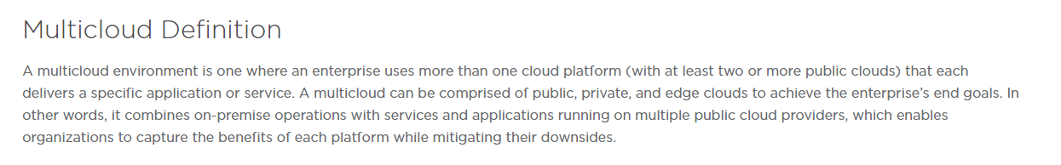

Slide 66
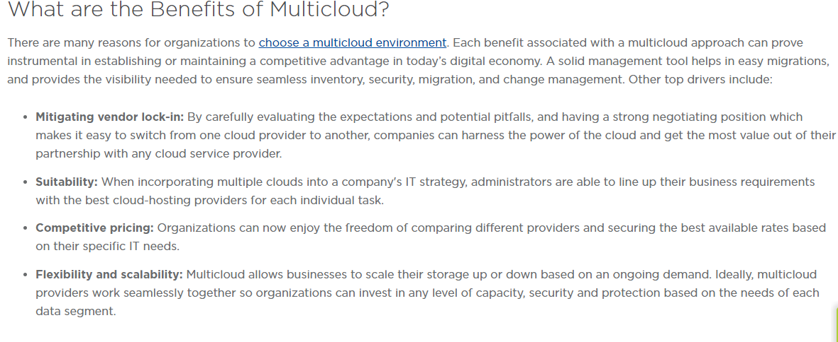

Slide 67
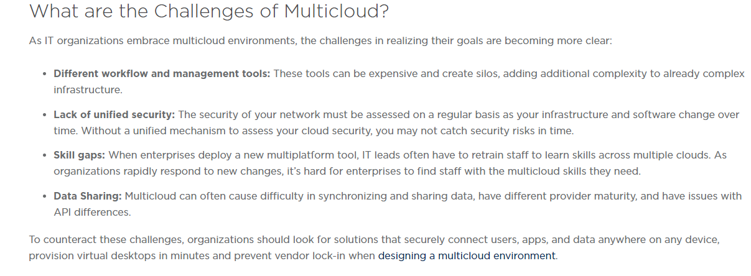

Slide 68
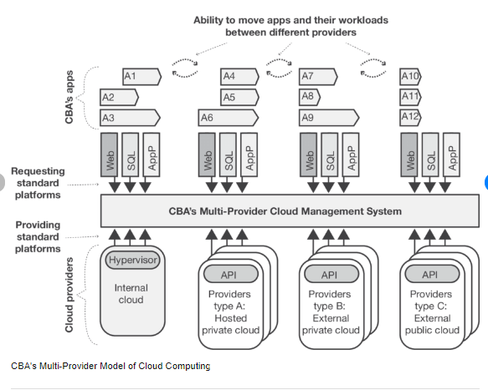

Slide 69
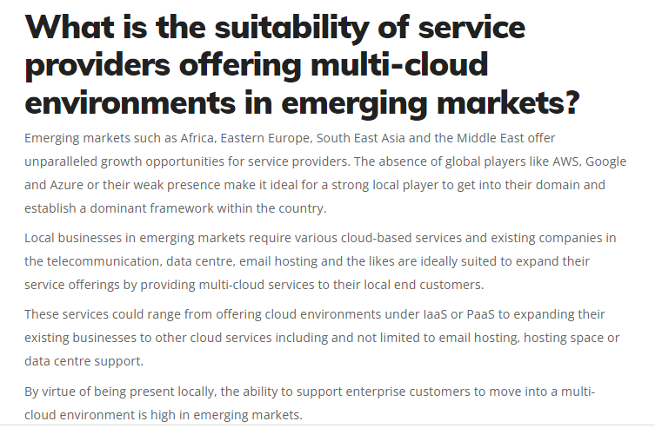

Slide 70
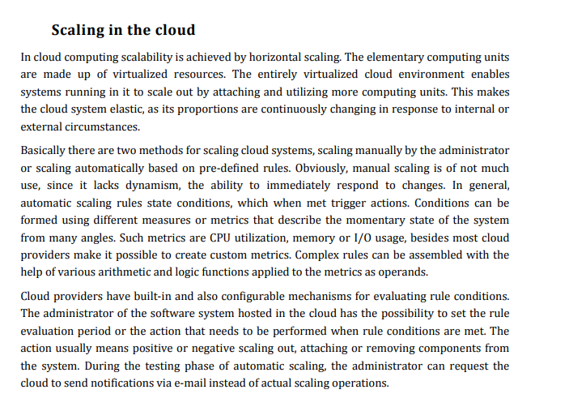

Slide 71
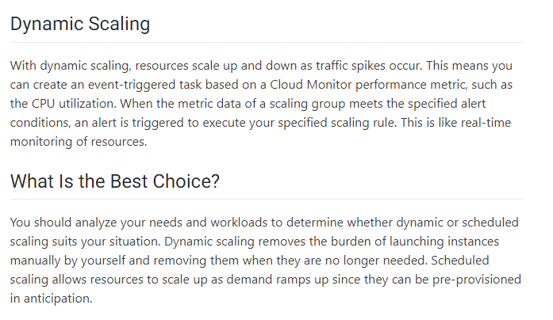

Slide 72
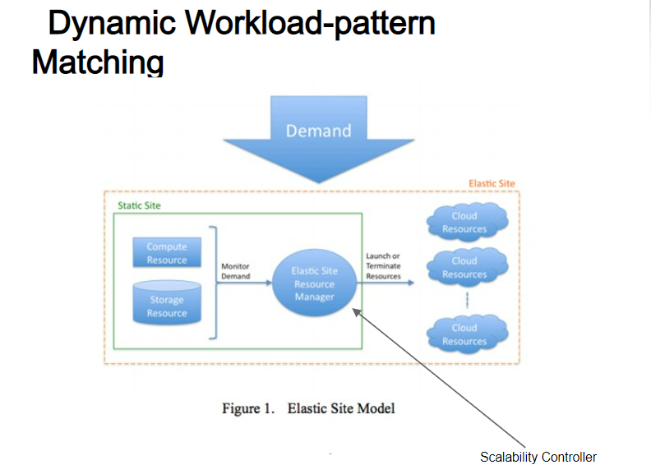

Slide 73
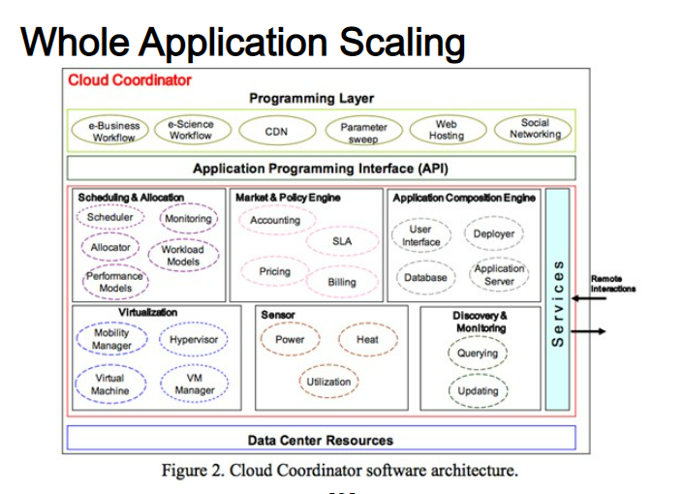

Slide 74


Slide 75


Slide 76


Slide 77


Slide 78


Slide 79


Slide 80


Slide 81


Slide 82


Slide 83


Slide 84


Slide 85


Slide 86


Slide 87


Slide 88


Slide 89

(Software Define Network)

Slide 90


Slide 91


Slide 92


Slide 93


Slide 94


Slide 95


Slide 96


Slide 97


Slide 98


Slide 99
Business Analytics, BI, Big Data, Data Mining - What’s the difference?
Business Analytics – Tools to explore past data to gain insight into future business decisions.
BI – Tools and techniques to turn data into meaningful information.
Big Data –data sets that are so large or complex that traditional data processing applications are inadequate.
Data Mining - Tools for discovering patterns in large data sets.

Slide 100


Slide 101


Slide 102


Slide 103
Key features of clouds to support the IoT
Several features available in clouds are requirements of resource-constrained objects
Flexibility of resource allocation
More intelligent applications
Energy saving
No on-site infrastructure
Heterogeneity of the smart environment
Scalability and agility
Virtualization

Slide 104
Clouds, Big data considering the IoT
Data stored in the “Cloud”
Data follows you & your devices
Data accessible anywhere
Data can be shared with others
Convergence
Contents
Computing
Communication
Connectivity
5C+5Any
Any Time
Any Where
Any Service
Any Network
Any Object

Slide 105
A conceptual diagram for the cloud-based Internet of Things
Cloud
-
based Services of Things
Smart
Services
Cloud Computing
Service
Software
Platform
Infrastructure
Provisioning
(
SaaS
)
(
PaaS
)
(
IaaS
)
&
Management
(Security, OAM,
Virtual Resources
Self Management)
(Control, transport, computing & storage, access resources)
Ubiquitous Access/
Seamless Connectivity
Smart
Environment
Humans
with Attached Devices
Objects
(Remote Monitoring and
Information Devices, Contents)

Slide 106
Integration of Clouds and the IoT
Combining clouds and the IoT
To support required resources to increasing heterogamous objects
To meet the dynamic computational needs of environmental applications with existing sensor network technologies
Benefits
The cloud can work on behalf of the object for increasing availability, maintaining performance and scalability.
The cloud can support resource continuity so that objects move freely changing access technologies while using resources from the same cloud.

Slide 107
The IoT using local distributed clouds
Public resource management, QoS management, Service invocation, Admission control
Location management, Service exposure, Billing, Identity management, Service
Support functions
Local resource management, Public cloud interaction
Resource exposure,
Resource Request

Slide 108

Exciting new challenges

Slide 109


Slide 110


